Slide 1

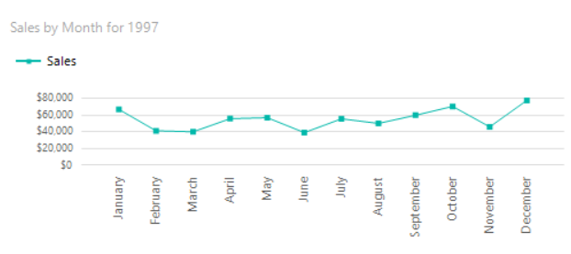
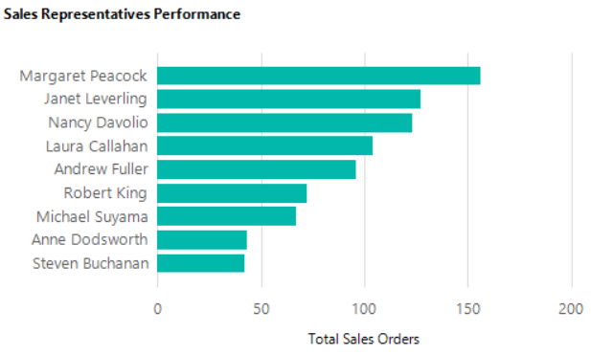
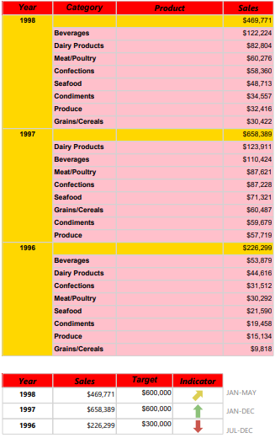
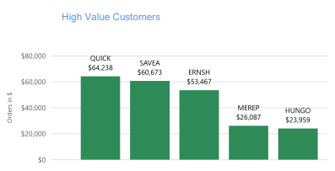
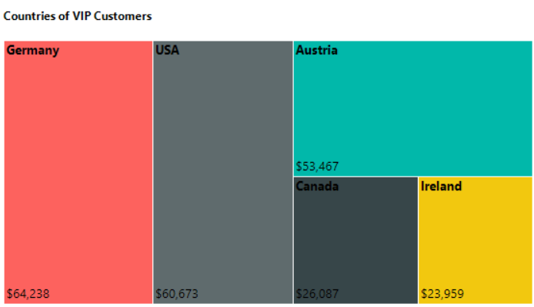
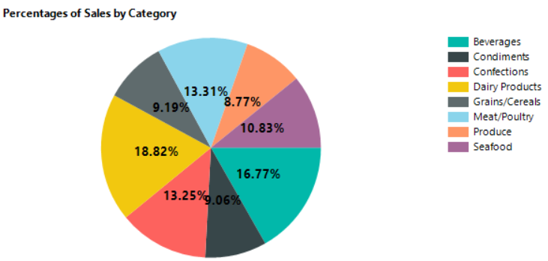
Northwind Traders
Andy Rey, Decoda Williams, Johanna Danton
Miami Dade College
OBJECTIVE
MONTHLY ANALYSIS
Assess the overall performance of the Sales Department.
Assess the performance of Sales representatives.
Define high-value Customers based on 1997
ANALYSIS OF SALES EMPLOYEES
SALES ANALYSIS
Based on the monthly analysis, we concluded that the months of September, October and December are the months with highest demands. Therefore; the company Northwind Traders should prepare based on the expected demand.
DEFINITION OF VIP CUSTOMERS
Mrs. Peacock placed 156 orders since the start of her career with the company, making her our top Sales Representative, followed by Mrs. Leverling (127) and Mrs. Davolio (123).
CONCLUSIONS
Our top 3 VIP customers are: Quick-Stop , Save-a-lot-Markets and Ernst Handel
Sale Rep: Margaret Peacock should get a “Best Sales Rep Award plus a bonus”
VIP Customer “Quick-Stop” should get a VIP prize and “Thank you for your business” letter.
According to the monthly analysis, the final quarter of the year marks the quarter with the highest demand in sales. Therefore, during those months, the product categories with the greatest demand should have the highest quantity of stock available.
European countries make up the majority of VIP customers, followed by North America. Based on this analysis, marketing strategies and logistic efforts should be focused on these 2 regions.
REFERENCES
Northwind Database:
https://github.com/Microsoft/sql-server-samples/tree/master/samples/databases/northwind-pubs
Our most sold Categories in 1997 were Dairy Products, Beverages and Meat/Poultry. Preparation for storage should be taken into consideration.
Our VIP customers are based out of Germany, USA and Austria.

